Slide 1
INTERACTIVE GRAPHICS PROGRAM
project prepared by Mykola Tsaryk & Irina Nutrikhina

Slide 2
Editor Features
8 figures of different complexity.
The ability to change the size, color, rotation angle, outline weight, filling for each of the shapes.
Convenient clipboard for shapes implemented on database technology.
Pleasant to the eye and intuitive interface with the implementation of context menus for tools
Easily remove shapes with "Smart Laundry"

Slide 3
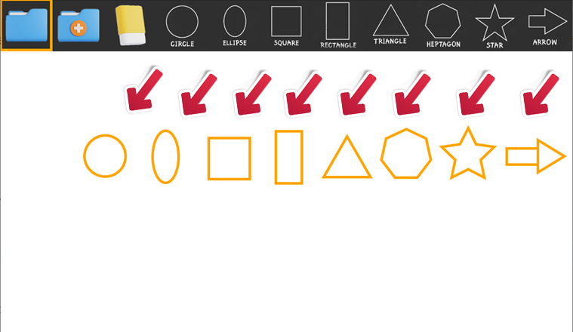
Shapes
Circle
Ellipse
Square
Rectangle
Heptagon
Star
Arrow

Slide 4
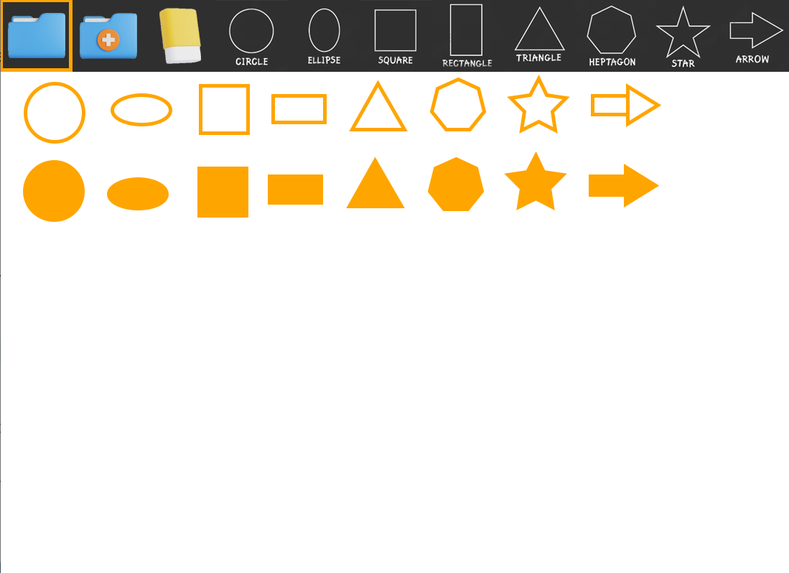
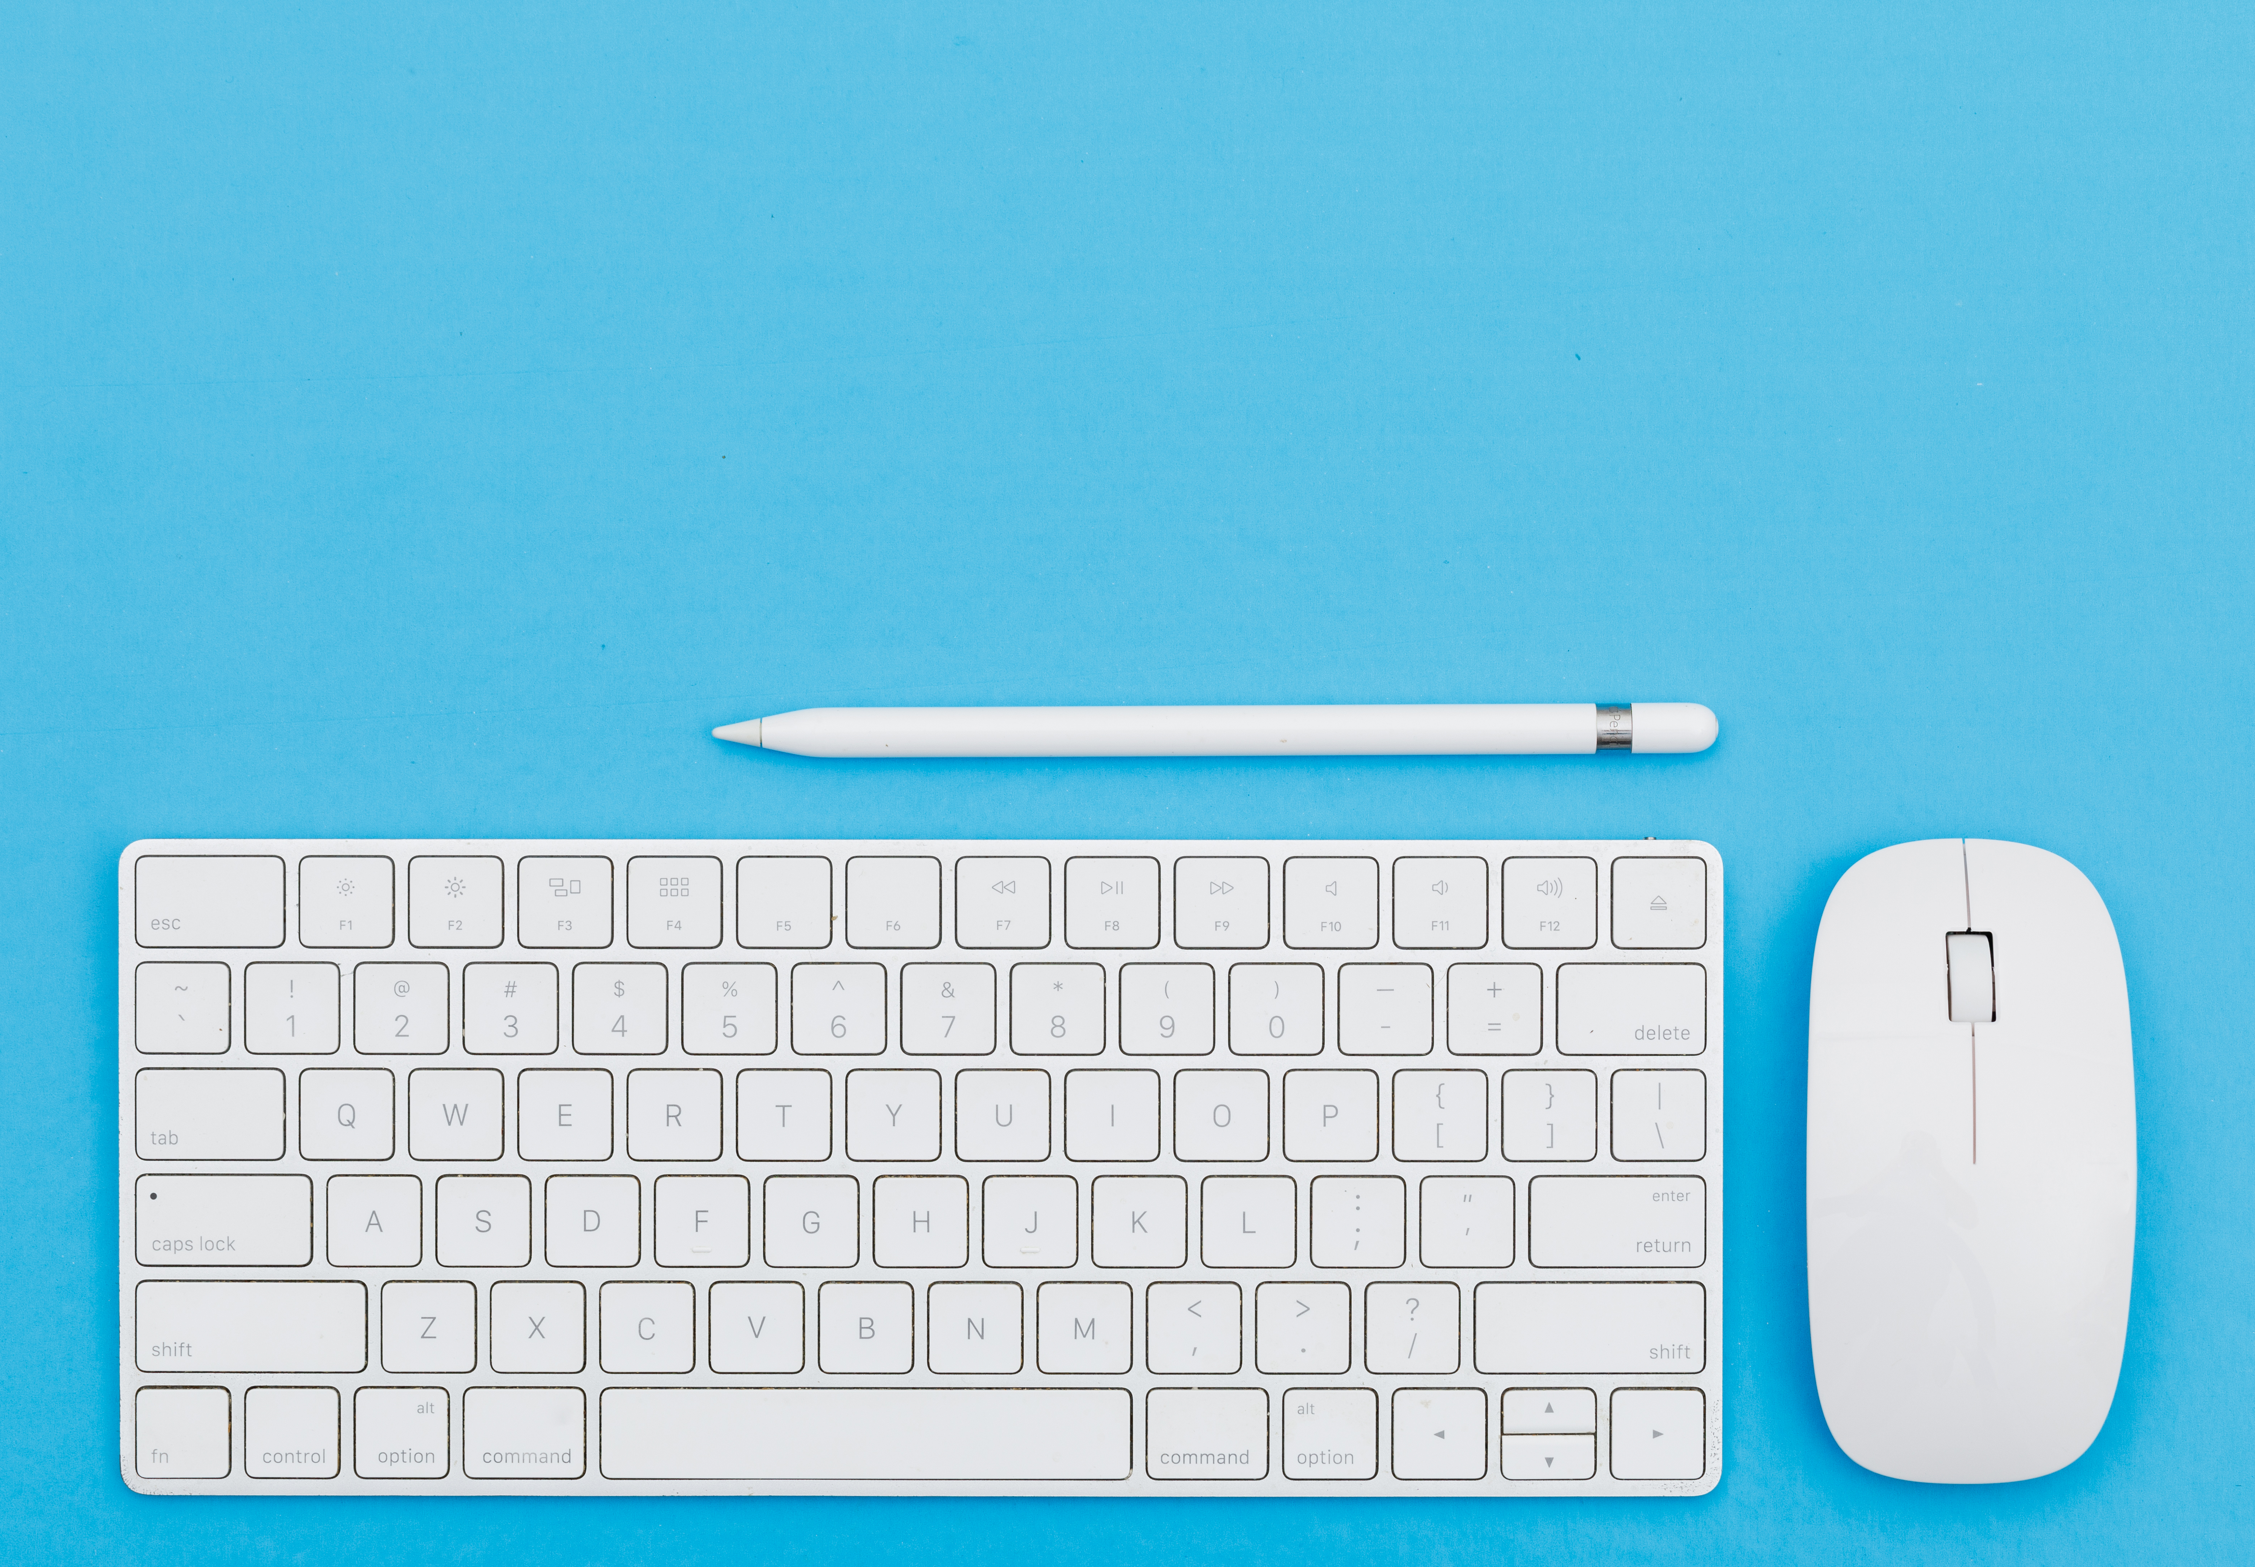
Filling
Each shape can be filled with a color by pressing the "F" key

Slide 5
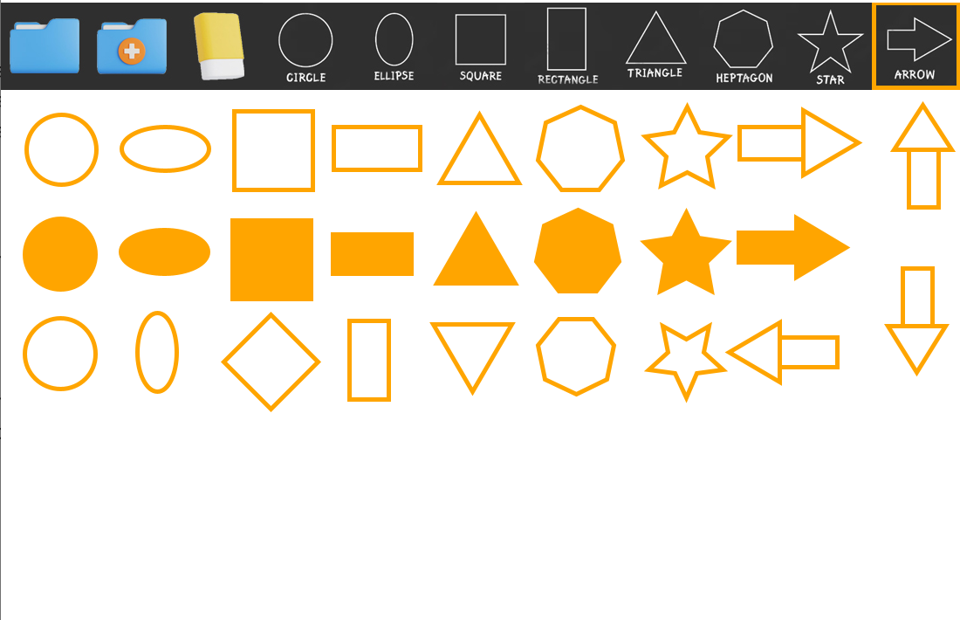
Rotation
Each shape can be rotated by pressing the "R" key

Slide 6
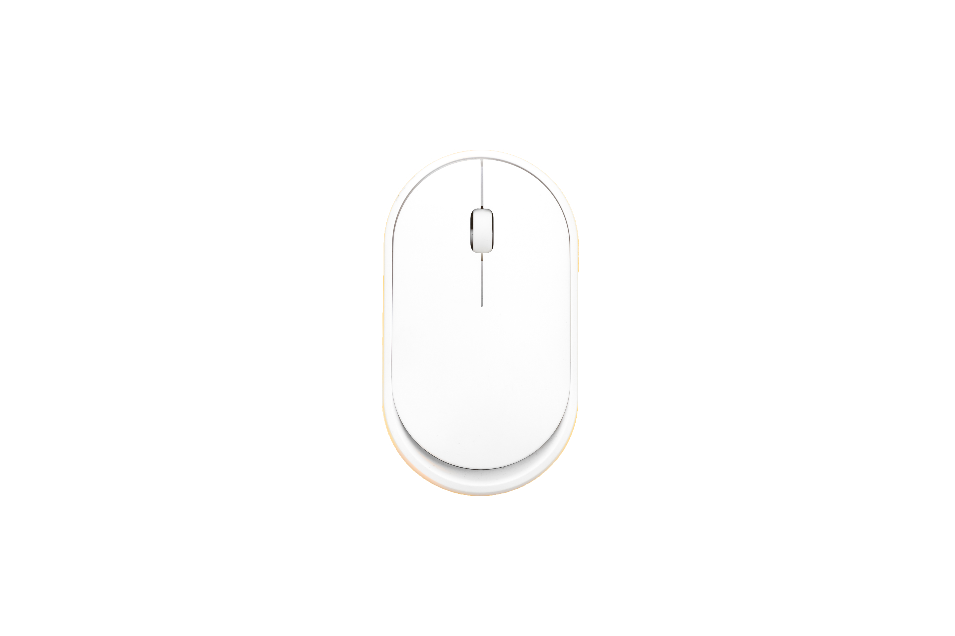
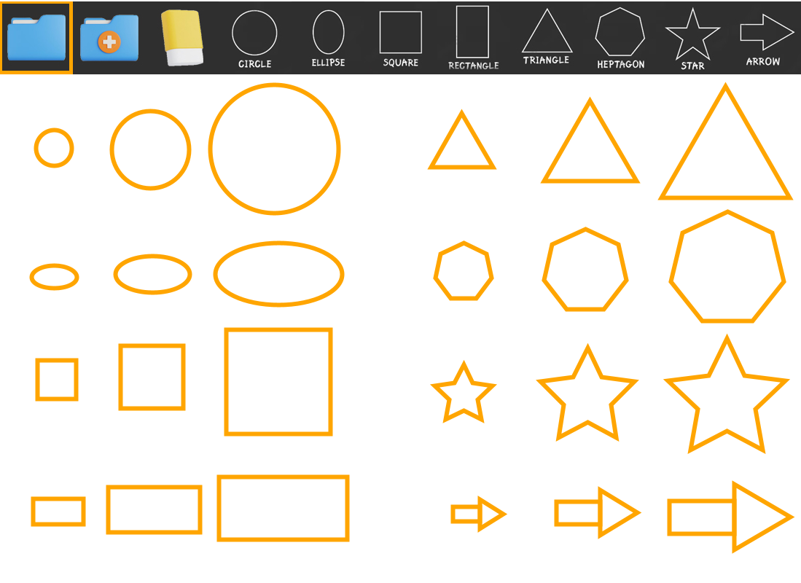
Size
The size of each shape can be changed using the mouse wheel. Scrolling up will increase the size, and scrolling down will make the shape smaller.

Slide 7
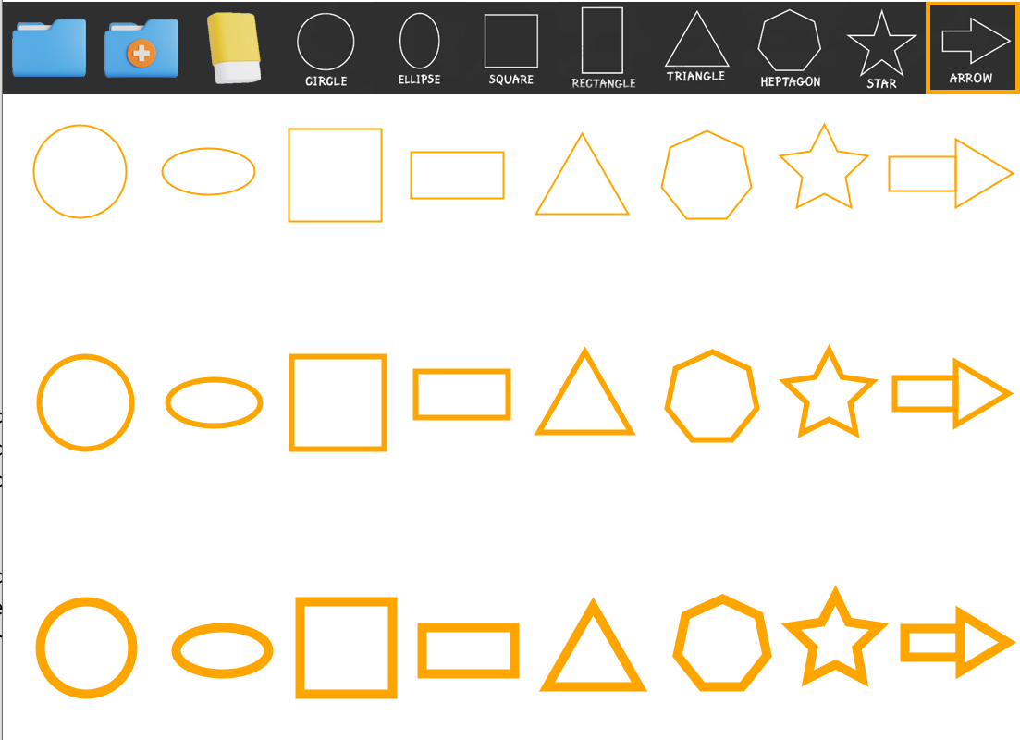
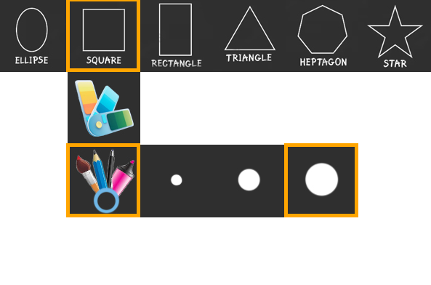
Outline weight
The weight of the outline can be changed in the context menu of the figure in the corresponding section.

Slide 8
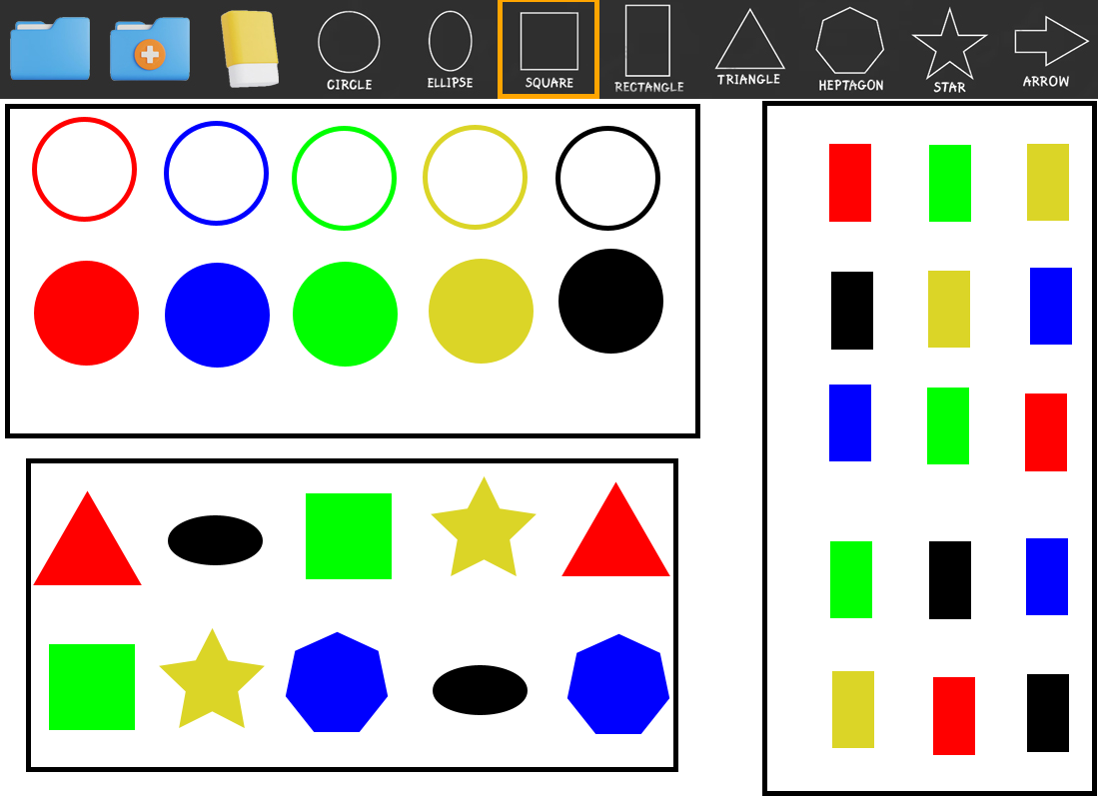
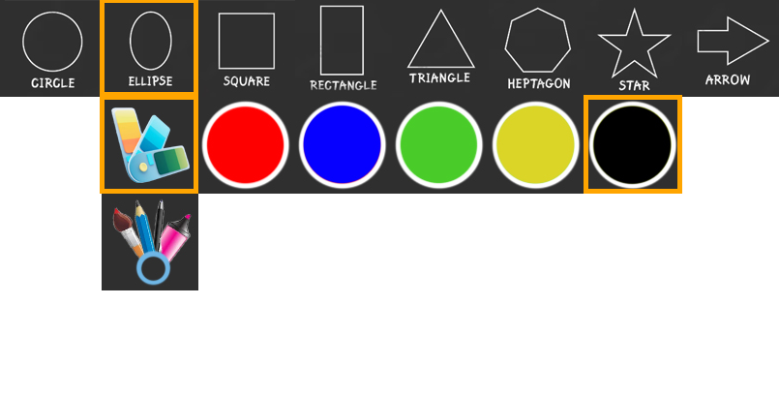
Color
The color can be changed in the context menu of the figure in the corresponding section as well.

Slide 9
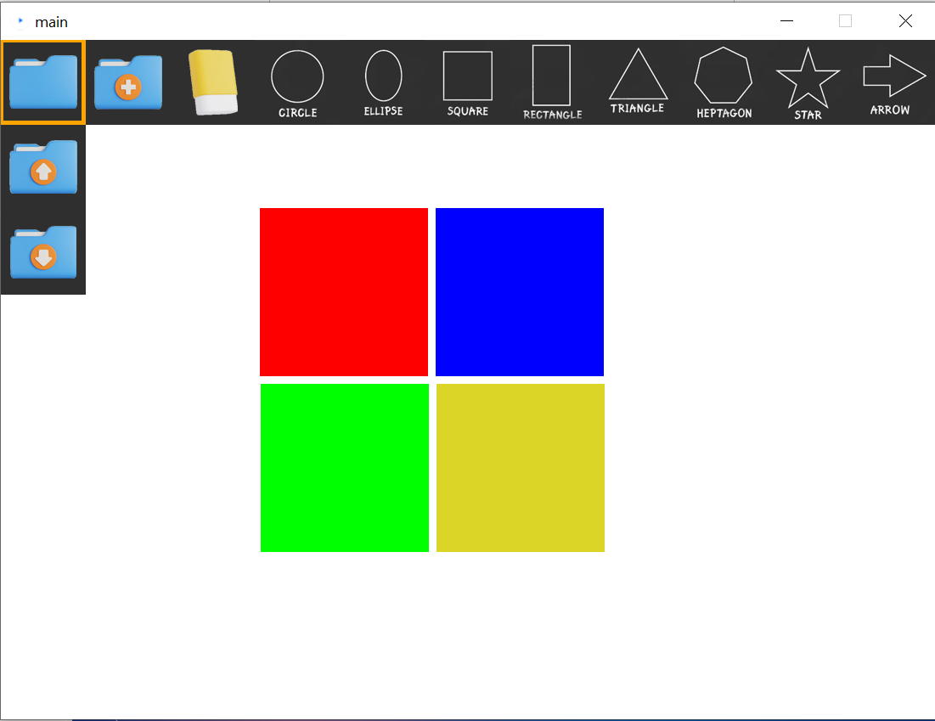



Database saving
You can load saved figures from the database by clicking on this button
You can also save your figures by clicking on this button.
In addition, you can clear the screen by clicking on this button (the shapes in the database will still be saved)

Slide 10
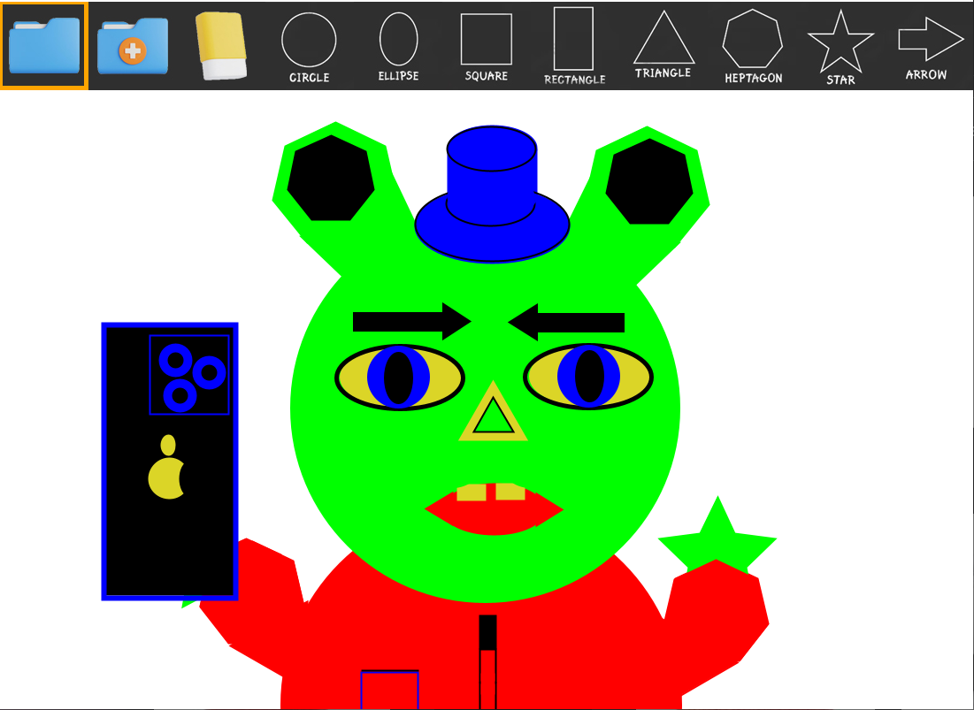
"Alien Selfie"

Slide 11
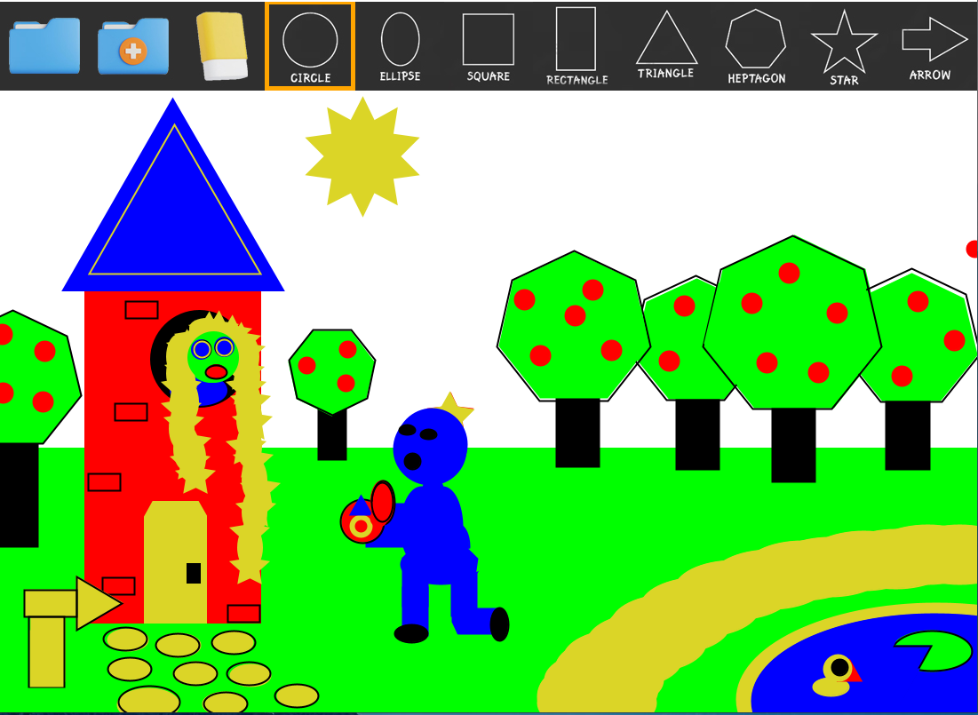
" Rapunzel, will you marry me? "

Slide 12


Thank you for your attention
Contact us:
Gmail
Telegram
GitHub

Slide 13
Links to image authors
https://ru.freepik.com/author/dedybakri
https://www.freepik.com/free-photo/computer-mouse-yellow-background-isolated-flat-lay_36165067.htm#query=computer%20mouse&position=29&from_view=search&track=ais
https://www.freepik.com/free-photo/back-school-concept-with-pencil-keyboard-mouse-blue-background-flat-lay_8999355.htm#query=keyboard&position=1&from_view=search&track=sph
https://www.freepik.com/free-vector/set-red-arrow-stickers_974540.htm#page=2&query=arrow&position=3&from_view=search&track=sph

